Slide 1
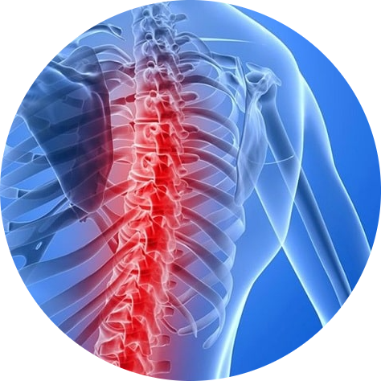
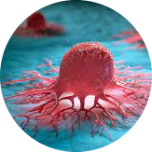
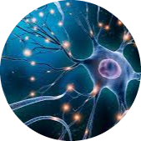
Muscular Atrophies
Cancer
Neurological Diseases
https://cordis.europa.eu/article/id/422287-new-insights-on-how-rna-modifications-work/de
https://www.scinexx.de/news/biowissen/neue-art-von-gehirnzellen-entdeckt/
https://www.hhmglobal.com/knowledge-bank/articles/spinal-muscular-atrophy-sma-an-introduction
Notes:
What have these diseases in commen? → They include RNA-binding proteins
Alisa

Slide 2
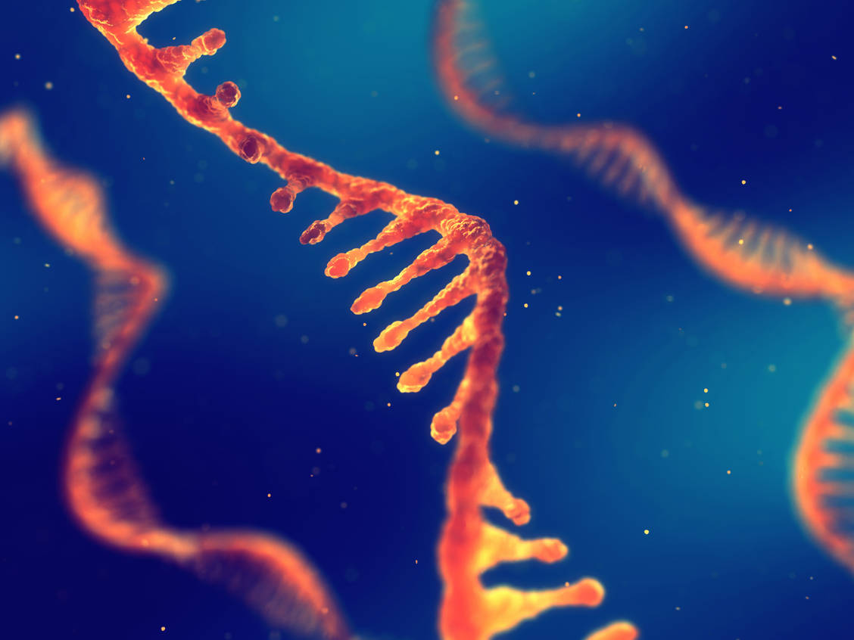
Non-synchronized HeLa cells
Project proposal
Team 01
Alisa Kirkin, Sina Kühnel, Ignacio Lozano Onrubia, Greta Pick
https://cordis.europa.eu/article/id/422287-new-insights-on-how-rna-modifications-work/de
Notes:
Alisa

Slide 3
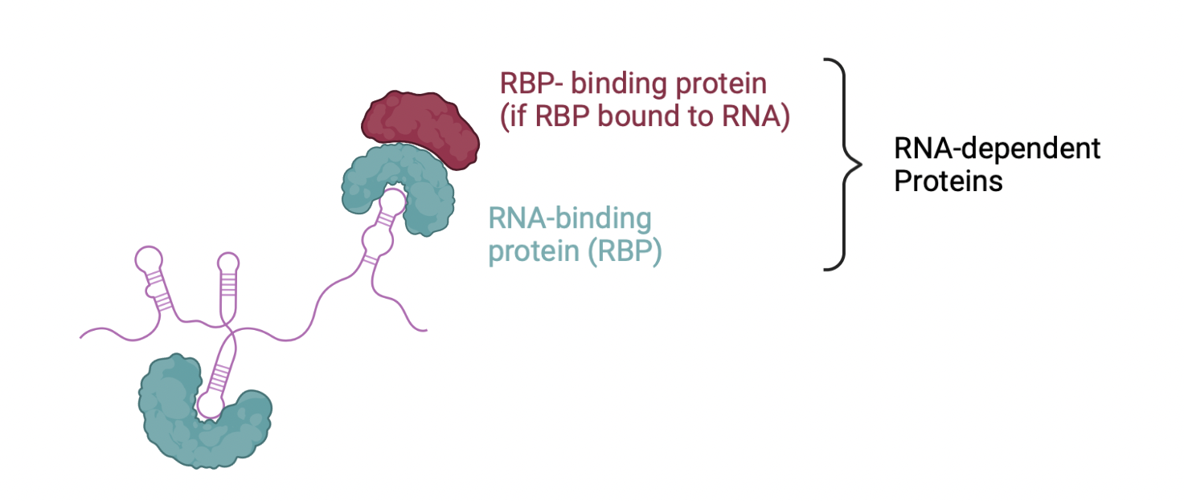
RNA-dependent Proteins
Created with BioRender
Notes:
What are RNA-dependent proteins?
RNA-dependent proteins include RNA-binding proteins and proteins that bind RNA-binding proteins. RNA-binding proteins bind RNA
Alisa

Slide 4
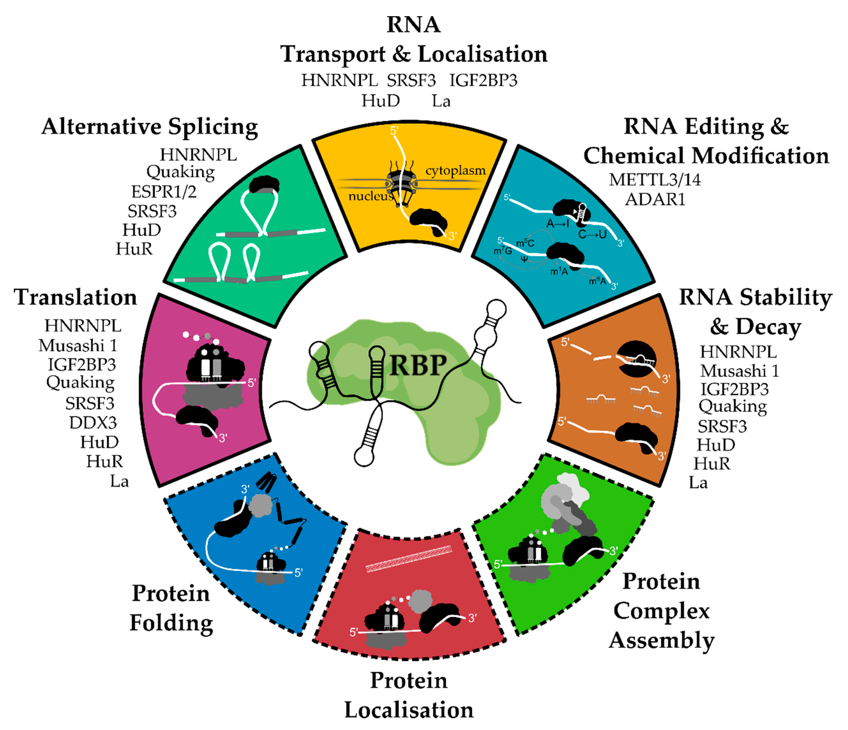
Role of RNA-binding proteins on a cellular level
Weiße, J. et al. (2020). RNA-Binding Proteins as Regulators of Migration, Invasion and Metastasis in Oral Squamous Cell Carcinoma. International Journal of Molecular Sciences 21, 6835.
Notes:
Importance of Rbp. They are involved in a variety of processes
Read slide
Alisa

Slide 5
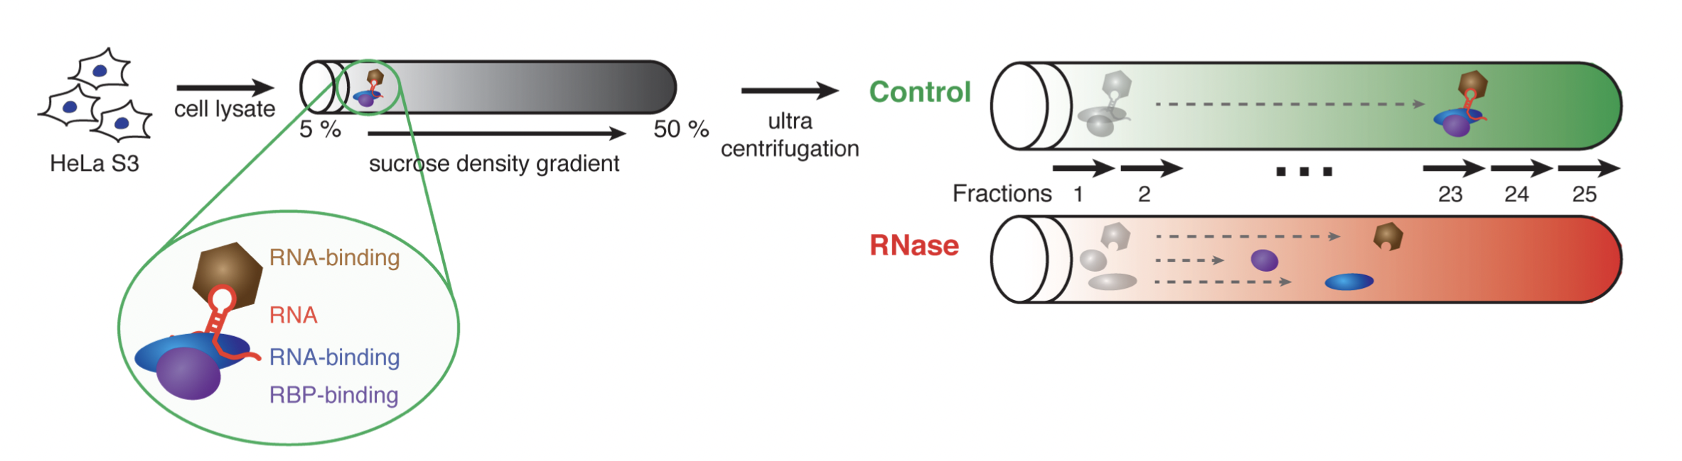
Generation of Data
Provided by Dr. Caudron-Herger, Maïwen
Notes:
How was our data generated. Explain slide
SIna

Slide 6
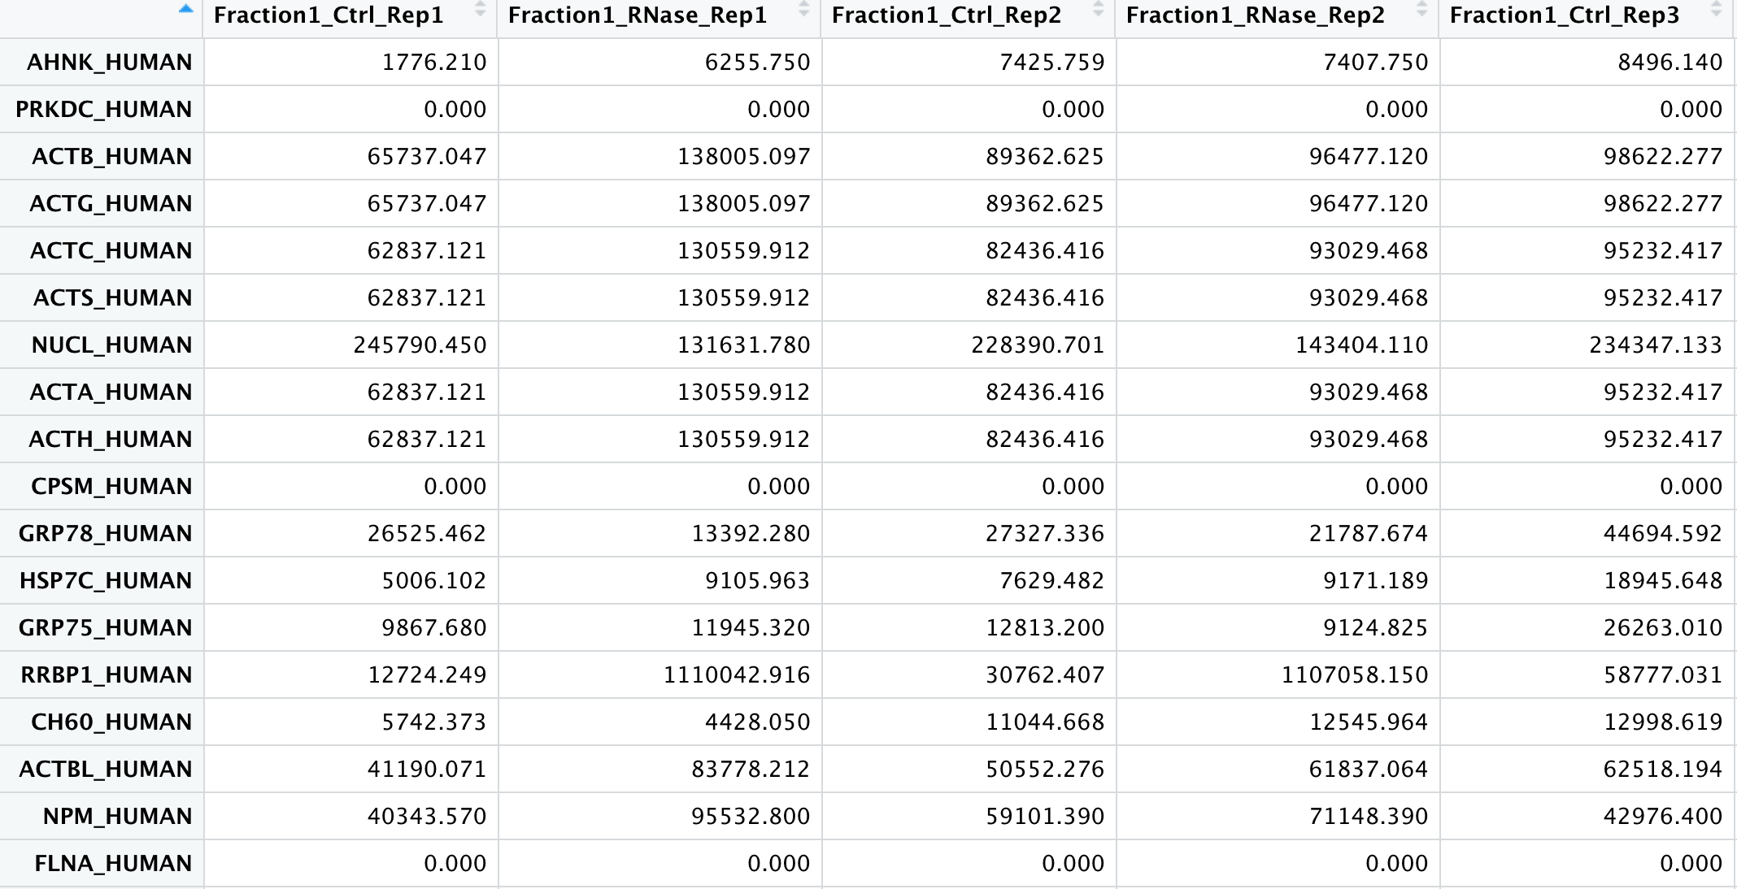
Description of Dataset
Fraction
Protein
For each Protein:
Ctrl and RNAse sample
25 fractions
3 replicates
4765 rows
Protein amount (arbitrary units)
150 columns
Notes:
Read
SIna

Slide 7
Timetable
Date | Achievements and analysis steps | Part
24.05. | Normalization and Clean-up | 1
31.05. | Identify Maxima and Gaussian curve | 2
07.06. | Impute and apply selection criteria for RNA-dependent proteins | 3
14.06. | Impute and apply selection criteria for RNA-dependent proteins | 3
21.06. | Graphics for specific proteins | 4
28.06. | Clustering of proteins with common behaviors | 4
05.07. | Comparison with data bases and create final report | 5
12.07. | Create final report and presentation
19.07. | Final Presentation
Notes:
Read and include weekly meetings on Sunday. Explain GitHub. Mention Part 1-5
Sina

Slide 8
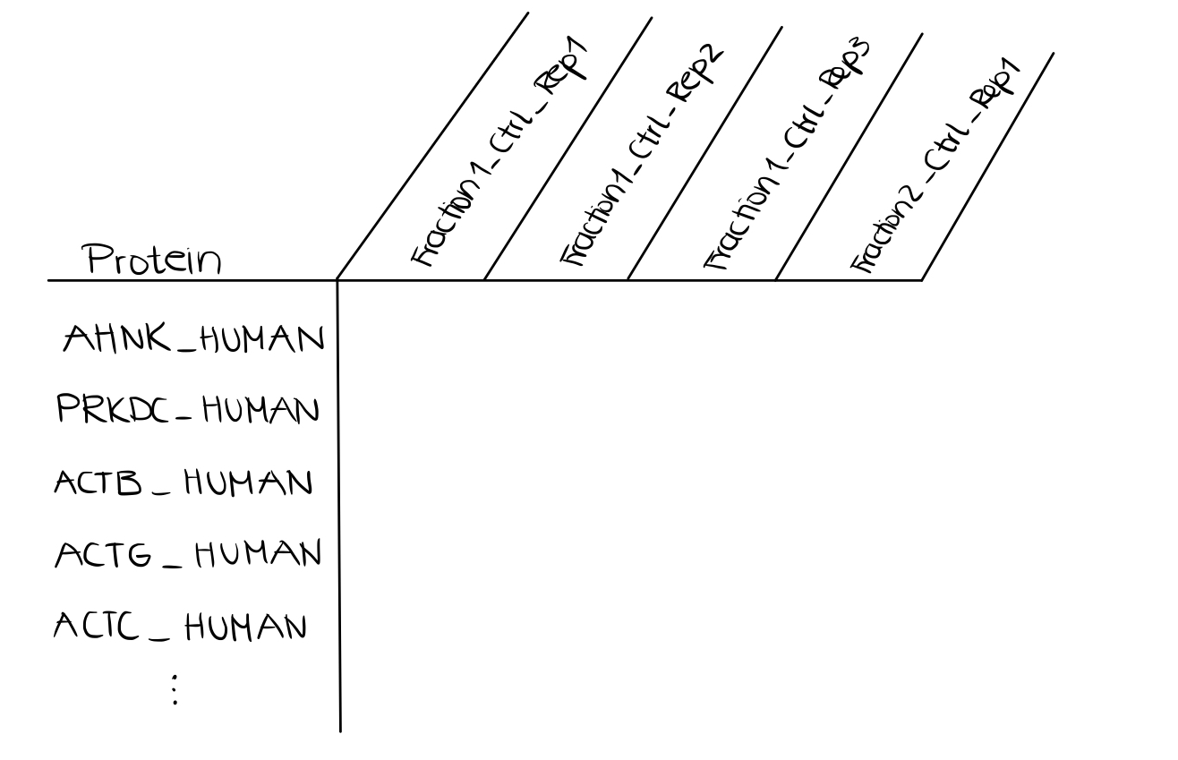
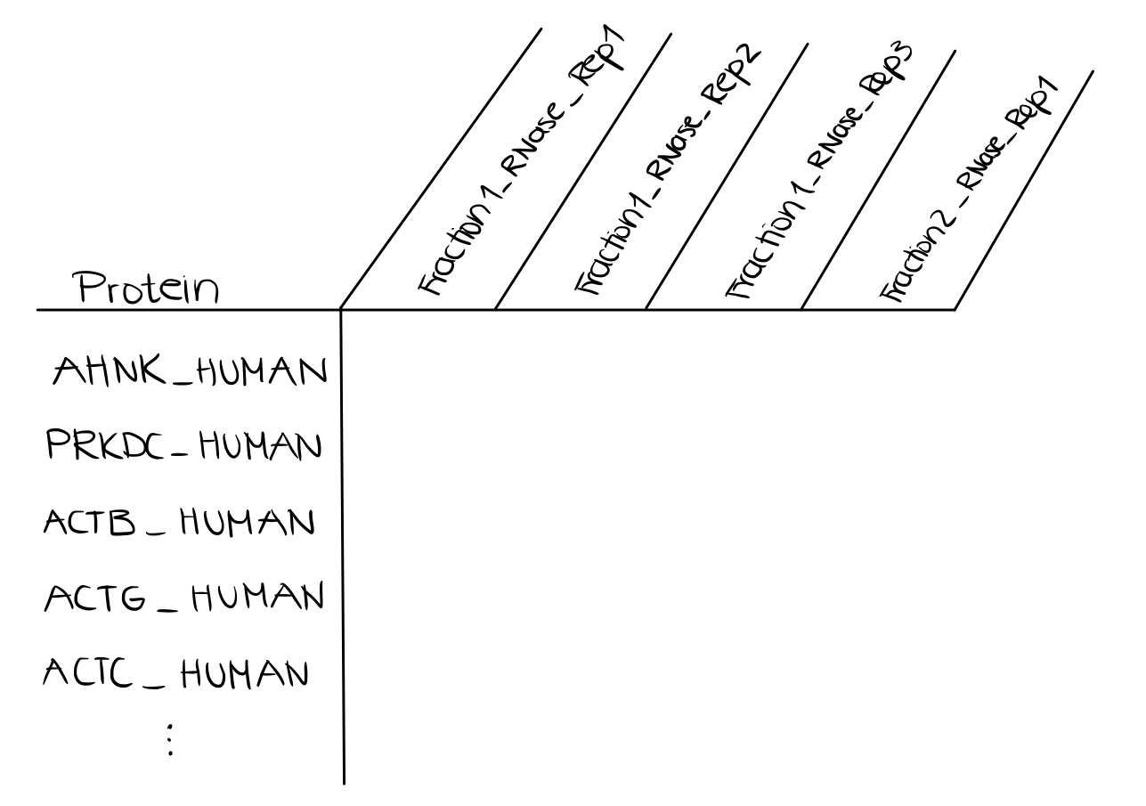
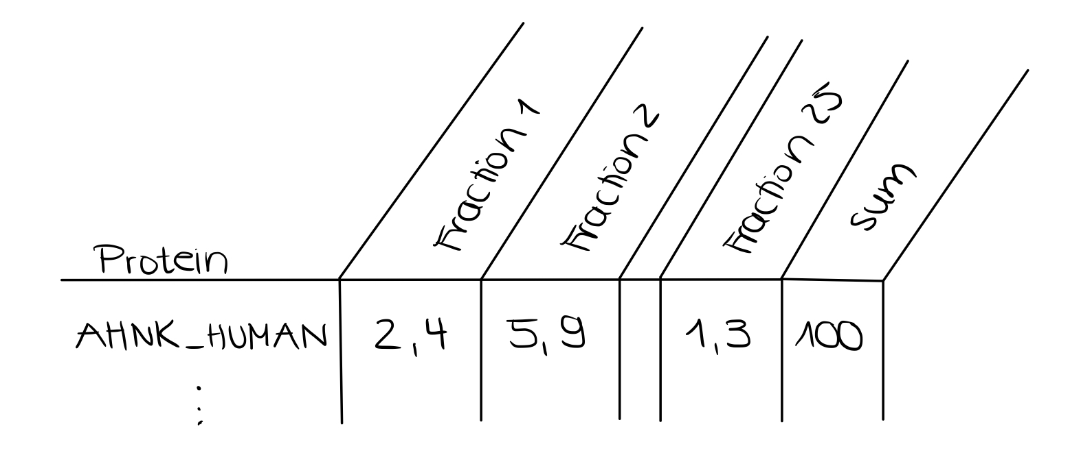
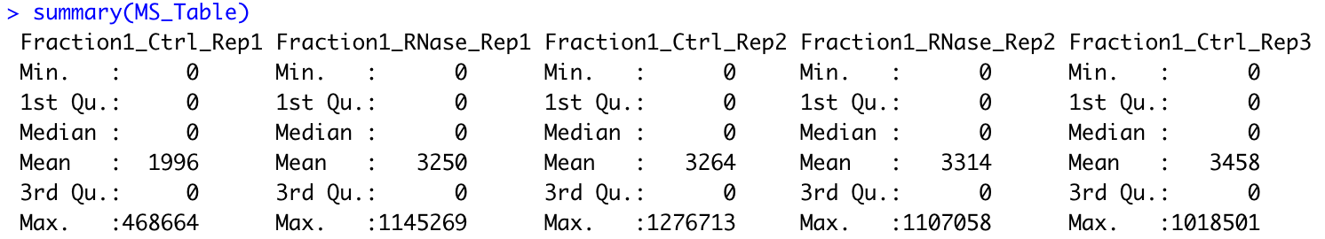
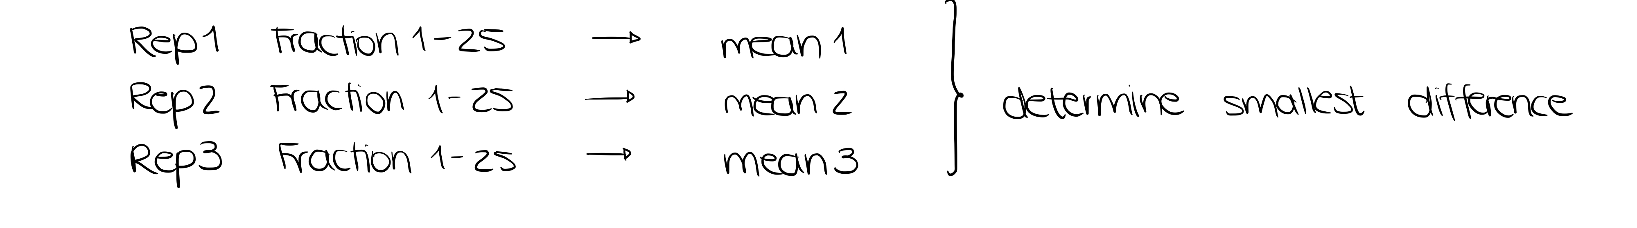
Part 1: Clean Up and Normalization
a) No missing values
b) Split Control and RNase
c) Normalization
d) Scaling
RNase
Control
Notes:
Part 1: Clean up and normalization
First: we checked for missing values, there are none. We used the function summary. No N.A.s visible
We decided to split control and Rnase to simplify the following process
We aim to normalize our data by computing the mean of all fractions for every replicate for each protein. Out of the means calculated we choose the two reps with the smallest difference of their means. We use these 2 reps to compute the mean for one fraction and create a new matrix.
Last step of clean Up process is to scale our date. We sum up protein amount of all fractions and set it to 100. Subsequently expressing the amount of protein in each fraction as a percentage.
Ignacio

Slide 9
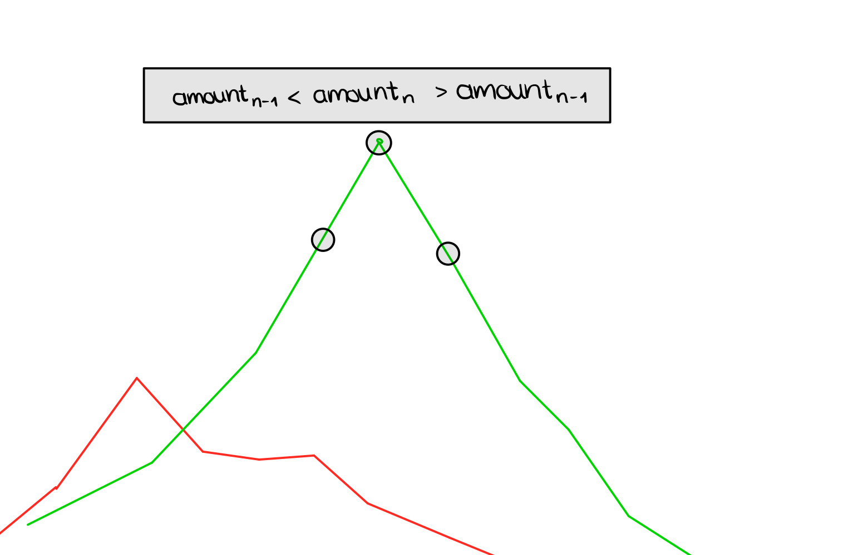
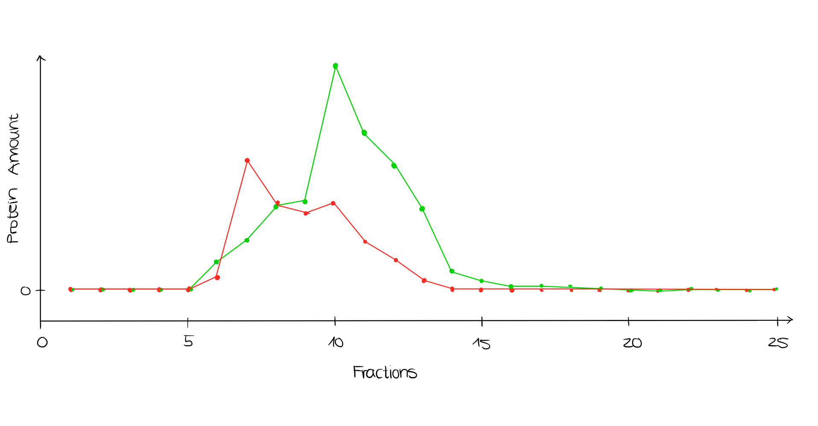
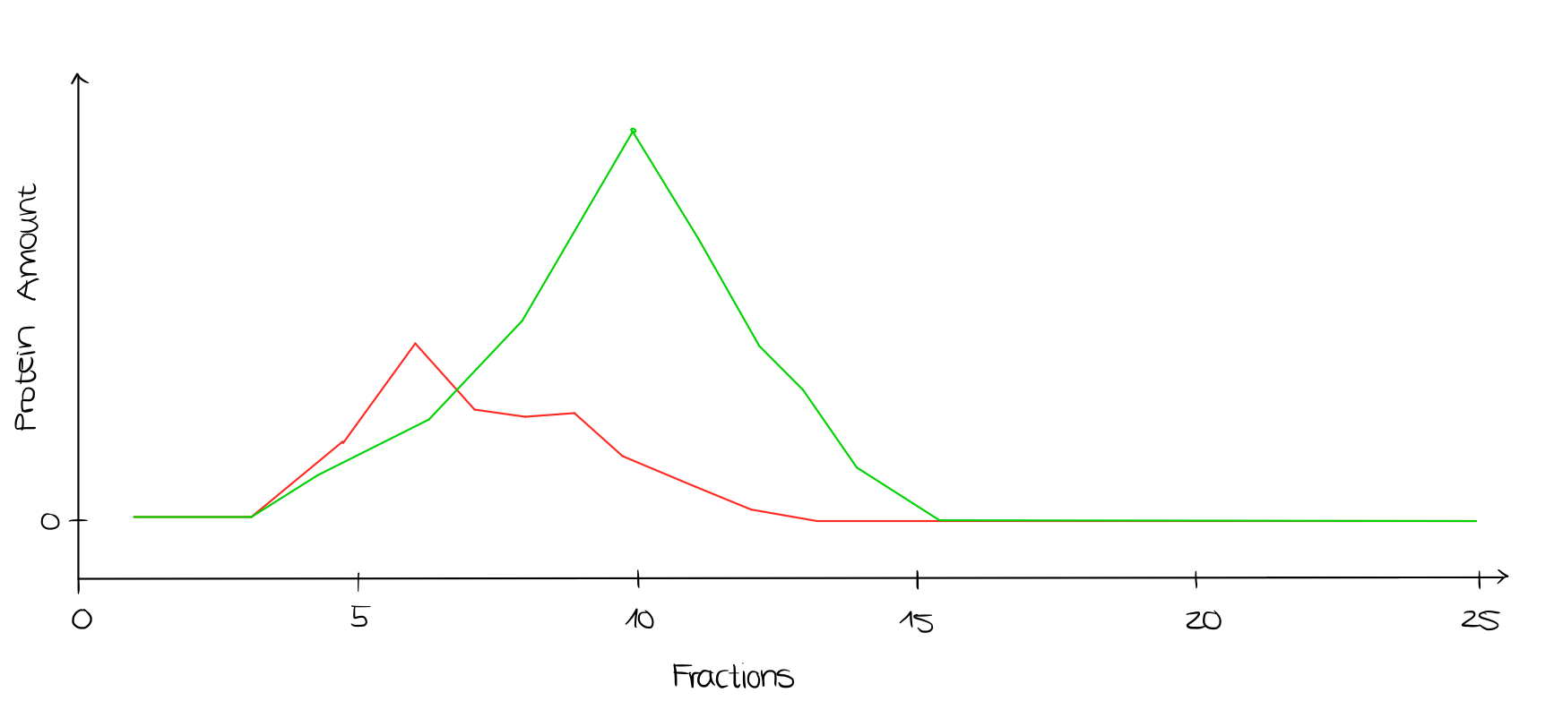
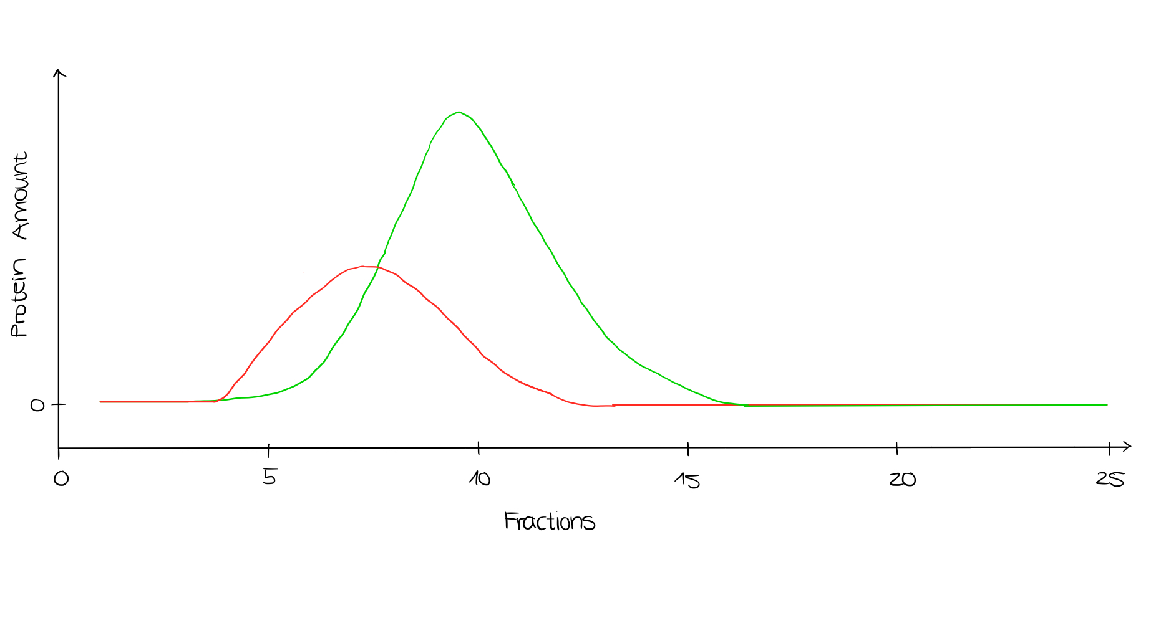
Part 2: Maxima and Gaussian curve
Smoothing the curve
Identification of global maxima: amount_{n-1} < amount_{n} > amount_{n+1}
Gauss fitting to the curve
Notes:
For better fitting of the gaussian curve, we smooth the graph by computing the mean of the protein amount in the fraction and the directly neighbouring fractions.
To identify the global maxima we will create a function that will compare the amount of protein in fraction n to the neighbouring fraction n-1 and n+1.
We can use the global maxima as the expected value to fit the gauss curve. For the fit of the curve we also need the standard deviation. We know that 1 sigma includes 34.1% of the toal protein amount.
Ignacio

Slide 10
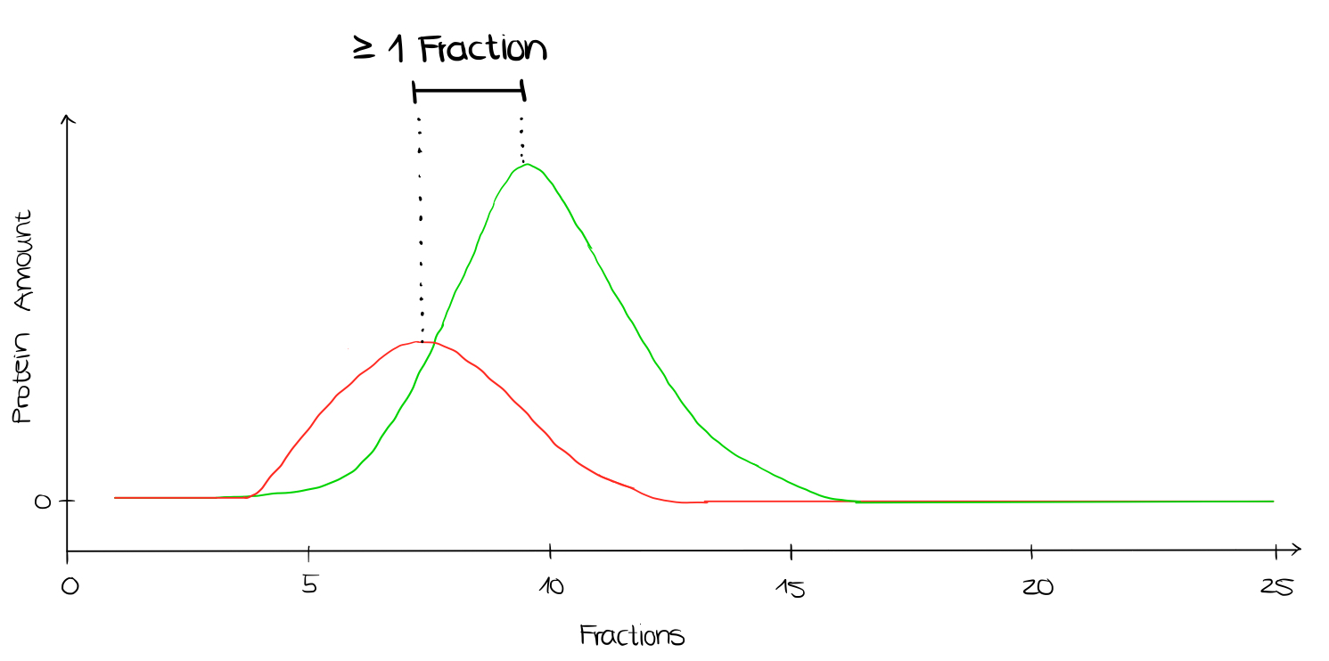
Part 3: Selection Criteria
Definition of selection criteria for significant shift
- shift of at least one fraction
Testing significance between Cotrol and RNase
- T-test (paired)
Notes:
Our selection criteria for rna-dependent proteins is a shift of the maxima for at least on fraction. Shift of maxima of one fraction is the ”smallest” possibe change.
We also want to run a paired t-test to determine the significance of our results.
Ignacio

Slide 11
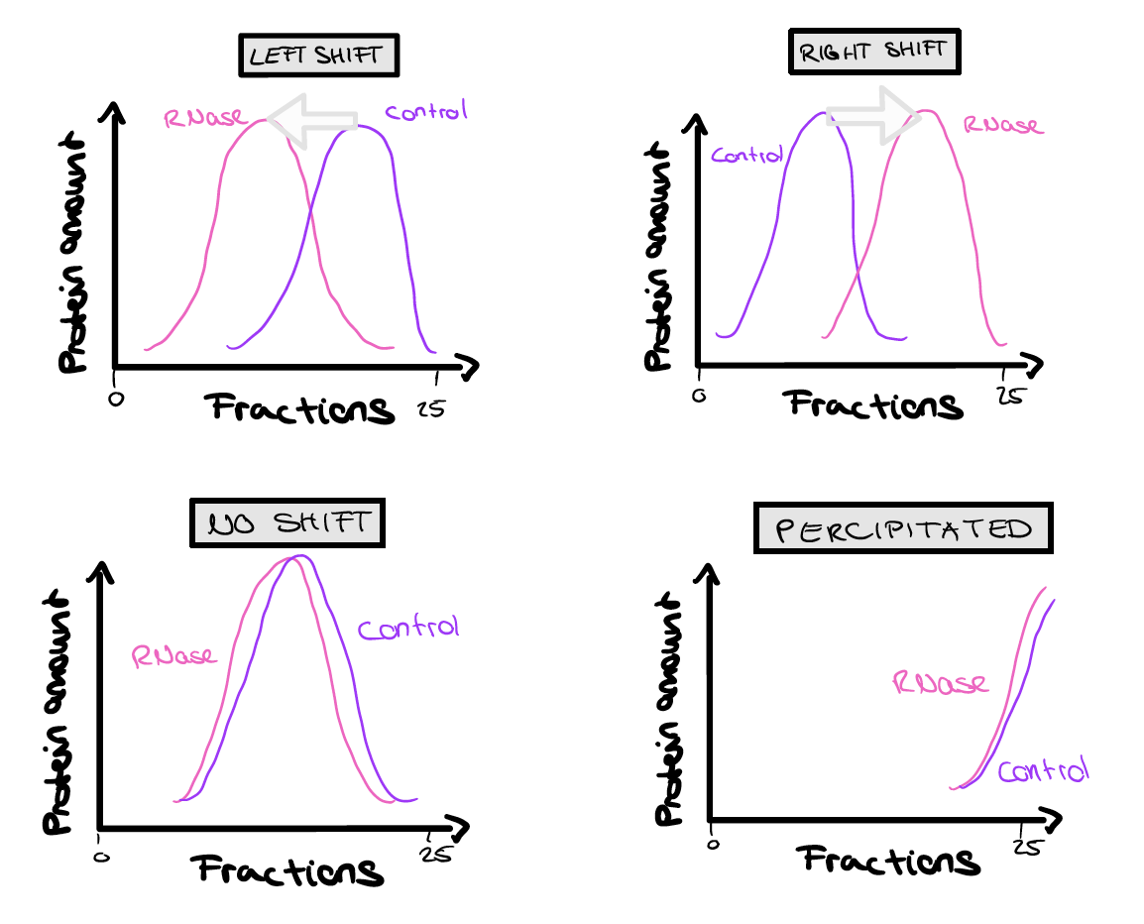
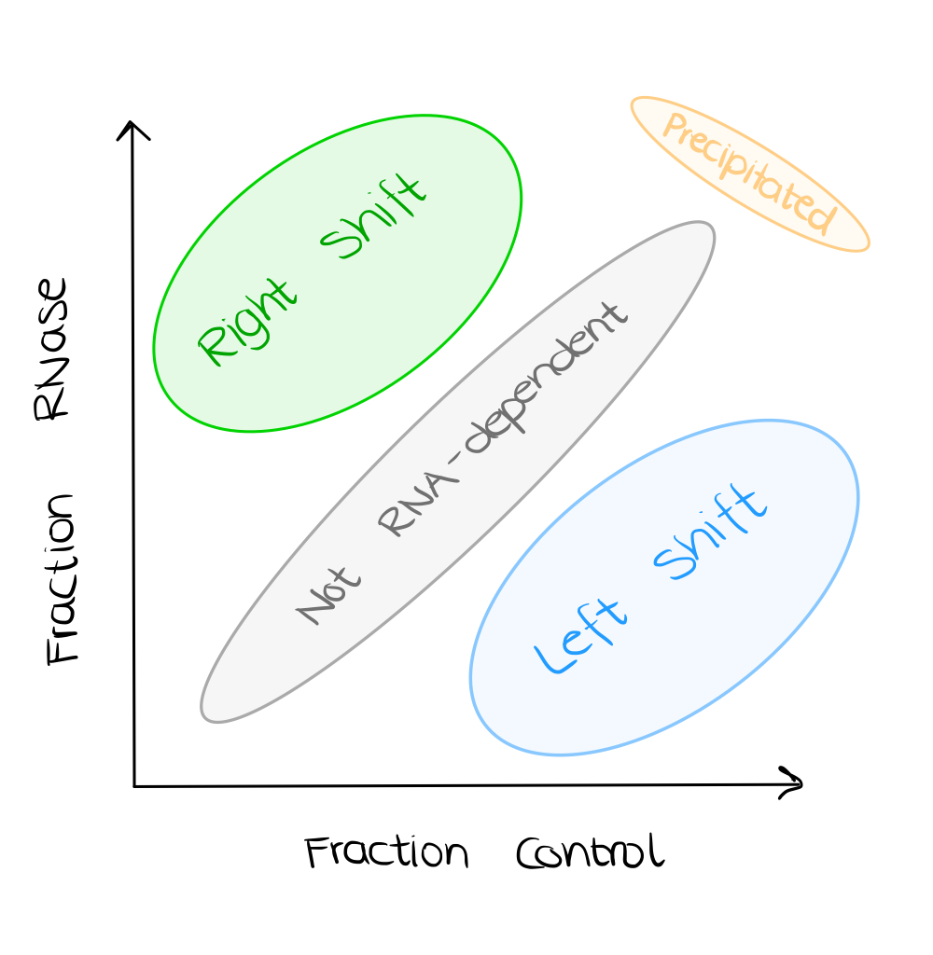
Part 4: Protein Shifts
Application of selection criteria
Production of graphs for
specific proteins
c) Clustering with k-means
Notes:
The next part is dedicated to protein shifts. We apply out selection criteria that we just explained to all proteins.
Then we want to pick out specific proteins and produce graphs. We look for one protein for each category: right-shift, left shift (what we expect for RNA-dependent), no shift or precipitated.
In Addition we want to use k-means clustering to visualize the categorization of RNA-dependent proteins. Here we use the maximum of each protein from control and Rnase and expect a similar clustering.
Greta

Slide 12
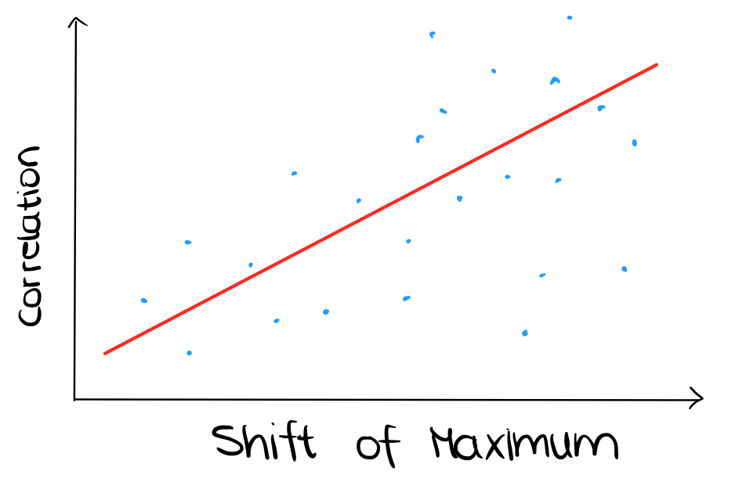


Part 5: Protein Data Bases
Comparison of own analysis with UniProt, RDeeP…
Regression Analysis
Notes:
As a last step we want to compare our own results: what proteins are RNA-dependent or not with data bases like UniProt and R-Deep. By comparing our positive RNA-dependent proteins with proven positives we can determine how well our code works.
Also we plan on doing conducting regression analysis. Our first idea is to use the correlation between fraction 1 of control and fraction 1 of RNase and so on to predict the shift of Maximum between RNAse and Control. We think about splitting out protein set and use one part to create the line of best fit and the other part of the proteins to test our model.
Greta

Slide 13
Part 6: Extra
Redefine critical parameters for more precise analysis
Analysis of proteins with partial shift
Notes:
If we have extra time at the end, we would like to redefine critical parameters for a more precise analysis.
In Phase 5, after the comparison, we may obtain non-RNA-dependent proteins that are proven to be RBP. Then we could for example change our criteria for a significant shift.
In addition we could further analyze proteins with a partial shift. Use CORUM to find out more about their protein-protein interaction.
Read
Greta

Slide 14
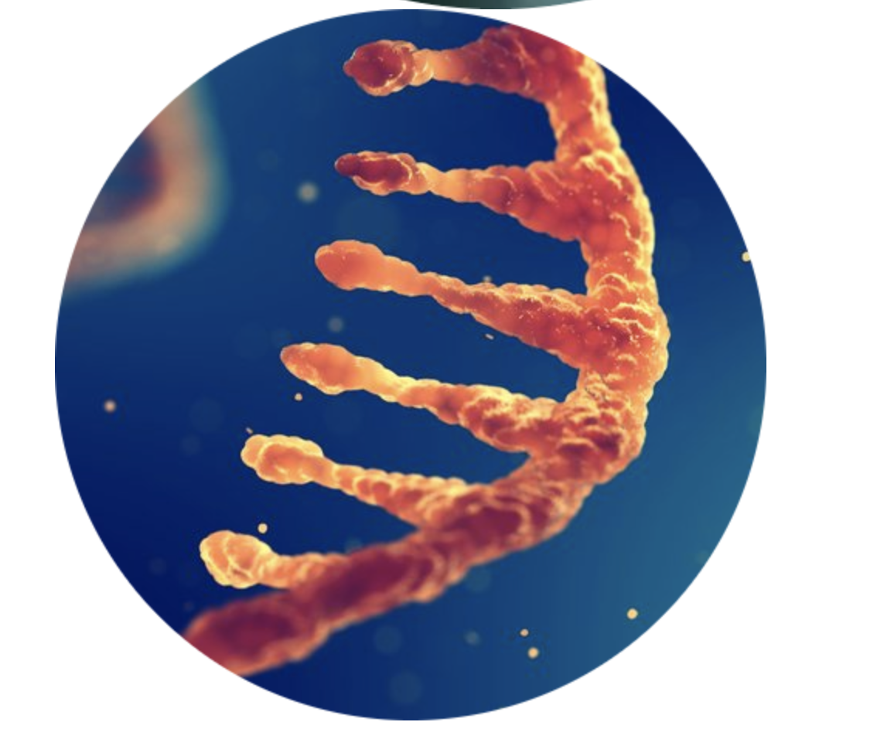
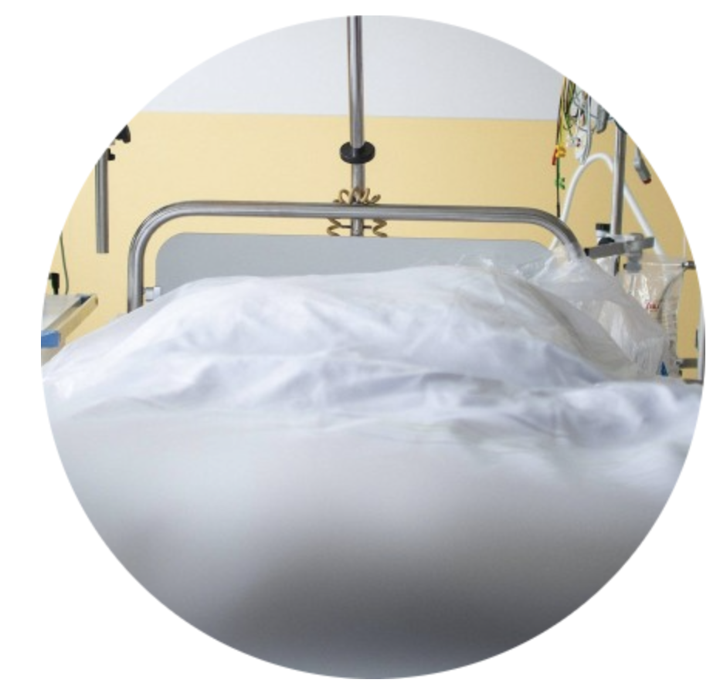
Why should you care?
https://www.drugtargetreview.com/news/53876/new-study-could-lead-to-better-treatments-for-autoimmune-diseases/
https://www.faz.net/aktuell/wirtschaft/leere-krankenhaus-betten-sind-zu-teuer-fuer-uns-alle-17321699.html
Notes:
So last but not least, why should you care about our project?
Because we showed why it is so important to find the proteins that interact directly or indirectly with RNA. It could bring us a step further in understanding the mechanism of a disease. And of course you should care because we are a great team and are super excited!!
Bild von uns einfügen!!!!
Greta

